Slide 1
U.S Cost of Living
Demiko Birden, Devin Fogerty, and Spencer Thompson

Slide 2
Project Proposal
We plan on using U.S cost of living data by county to analyze key factors such as housing, food, healthcare, transportation, childcare, as well as tax rates, to determine a comprehensive picture of cost of living in different counties within the state of Ohio, and if possible, throughout different regions of the U.S.

Slide 3

Question: Do metro or Rural Areas have a higher cost of living?

Slide 4
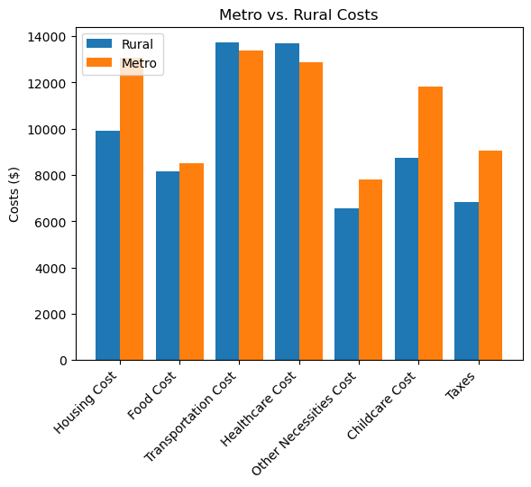
Cost of Living: Metro vs Rural
Metro areas have higher costs compared to rural areas. Metro areas spend $3,165.47 more on housing than rural areas. Both metro and rural areas have comparable food costs. With transportation cost metro areas have slightly lower costs compared to the rural areas spending $343.56 less. Rural areas spend slightly more on healthcare compared to metro areas with a difference of 156.28. With other necessity costs metro areas spend more compared to rural areas with a difference of $1,265.85. When it comes to childcare Mero areas also spend significantly more at $3,089.59. Metro areas also pay higher taxes with a difference of 2,240.45. Based on the data we gathered it appears that living in rural areas generally results in lower overall costs of living however it is important to recognize while cost of living may be lower in rural areas there are trade offs in terms of access to certain services and amenities as well as job opportunities.

Slide 5
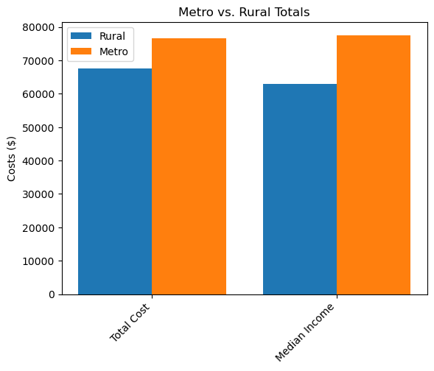
Metro vs Rural Income
In both metro and rural areas, the total cost of living and median income is around the same which shows that some people may have disposable income.

Slide 6


Question: Which counties in each state have the highest/lowest cost of living?

Slide 7
Cost of Living: County vs County

Slide 8

Question: Do families with children have significantly higher cost of living, and how significant are childcare costs compared to total income?

Slide 9
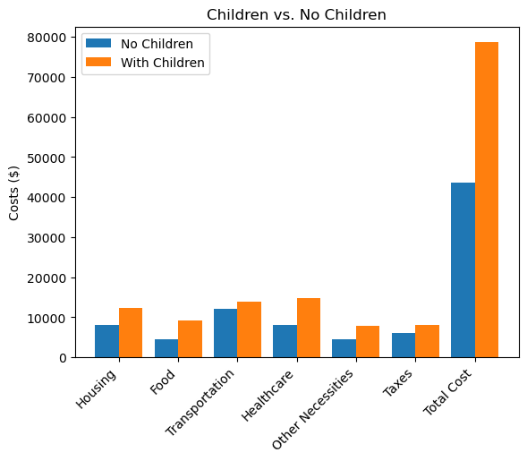
Cost of Living: Children vs No Children

Slide 10

Question: What percentage of total family income goes towards housing in each county?

Slide 11
Family Income vs Housing

Slide 12


Question: What percentage of total family income goes towards food, and do metro or rural counties spend more?

Slide 13
Family Income vs Food

Slide 14
Cost of Food: Metro vs Rural

Slide 15

Question: Do counties outside of metro areas have higher transportation costs?

Slide 16
Transportation Costs vs Non-Metro Areas

Slide 17

Question: Are healthcare costs higher for families with children?

Slide 18
Healthcare Costs vs Children

Slide 19

Question: Do metro areas spend more or less than rural areas on healthcare?

Slide 20
Healthcare Costs: Metro vs Rural

Slide 21

Question: How significant of an effect do taxes have on cost of living, and what percentage of total income goes straight to taxes?

Slide 22
Cost of Living vs Taxes

Slide 23
Total Income vs Taxes

Slide 24

Question: What regions have the highest/lowest cost of living?

Slide 25
Cost of Living: Region vs Region

Slide 26
Images
https://images.app.goo.gl/GgWSdm2HagtDBbdS7
https://images.app.goo.gl/jC3w3Jho7CqAgHhi7
https://images.app.goo.gl/LUhhGcW6LeijZ52FA
https://images.app.goo.gl/oLe9fSDHEgUqBPBF6
https://images.app.goo.gl/5nreBEPUZPGeUGBZA
https://images.app.goo.gl/ncwpaEBJqp7a99cR7
https://images.app.goo.gl/6wA7AaWFej2vfciQ9
https://images.app.goo.gl/2qXahfDZc5DoUWp77
https://images.app.goo.gl/dBRrBJycNGB5wL5D9
https://images.app.goo.gl/zno5aD51S3eMjPdN7
https://images.app.goo.gl/XnMsqvKW2sarXZ6E9
https://images.app.goo.gl/JXyHvF2ScQXLcfKb6

